Slide 1
Combined conversion of petroleum residue and vegetable oil
Russian Academy of Science
Siberian Branch
Institute of Petroleum Chemistry
Postgraduate student:
Stanislav Boyar
Supervisor:
Ph. D of Chemical Sciences, Senior Scientist
Mikhail Kopytov
RAST-2020
Notes:
Hello everyone. I want to show you the work that I have been doing recently.

Slide 2
Contents
Problems of processing of heavy oils
Thermal cracking
Experiment
Results
2
Notes:
I will tell about current problems in oil production and processing. We will consider the basics of thermal cracking briefly. After this I will show you some results of my own experiments. Let’s start from the beginning.
Resources of light and medium oils are depleting inevitably over time. Soon, we will be recovering only heavy oils. Processing of heavy oils is very difficult and unprofitable. The demand in raw materials can be met by increasing the depth of processing of heavy feedstock. Besides, different additives can help here too. But heavy crude oils contain large amounts of resins and asphaltenes. During the reaction resins and asphaltenes lead to coke formation that kills the catalysts. Therefore, non-catalytic processes seem like a viable option. At the moment, transformations of resins and asphaltenes are still understudied.

Slide 3
Table 1. Physicochemical parameters of the Zuunbayan fuel oil residue
Parameters | Residue
Condarson carbon residue, wt. % | 6.35
Elemental composition, wt. %:
С | 86.91
H | 11.12
S | 0.10
N | 0.72
O | 1.15
Н/С | 1.52
Content, wt. % :
- n-alkanes | 26.40
- paraffin wax | 15.71
- oils | 74.1
- silica gel resins | 25.5
- asphaltenes | 0.4
IBP, °C | 350
Notes:
Thus, the goal of our research was to determine the influence of adding vegetable oil in heavy residue on the composition of resin-asphaltene substances in thermal cracking products.
In our research we used Zuunbayan fuel oil and vegetable oil.
The fuel oil contains a large amount of resin and n-alkanes but a small count of sulfur and asphaltenes. This allowed us to get additional amounts of light fractions.

Slide 4
Table 3. Characteristics of sunflower oil
Table 2. Compare of vegetable oils (literature data)
Vegetable oils | Unsaturated index, %
Cocount | 1.2
Rapeseed | 4.7
Mustard | 6.4
Sunflower | 9.0
Parameters | Values
*Fatty acids content, wt. % :
Palmitic (C₁₆:0) | 7.1
Stearic (C₁₈:0) | 5.2
Oleic (C₁₈:1) | 14.6
Linoleic (C₁₈:2) | 73.1
* – The ratio of carbon atoms to the number of double bonds in the acid molecule is shown in parentheses.
Notes:
(Next slide have a picture)
The vegetable oil contains unsaturated oleic and linoleic fatty acids which helps it actively react with hydrocarbon feedstock and have influence on conversion of resins and asphaltenes.

Slide 5
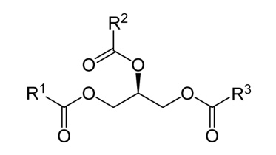
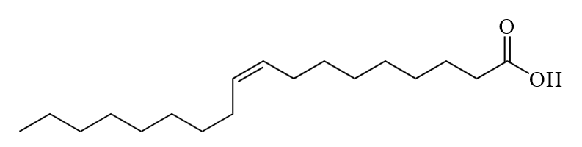
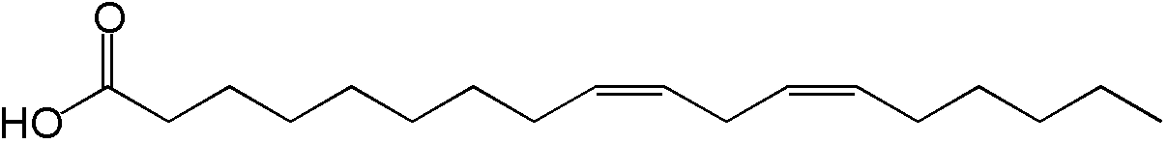
Triglycerides
Palmitic acid
Oleic acid
Stearic acid
Linoleic acid
Figure 1. Fatty acids
Notes:
The vegetable oil contains unsaturated oleic and linoleic fatty acids which helps it actively react with hydrocarbon feedstock and have influence on conversion of resins and asphaltenes.

Slide 6
Characteristics of microspheres
Before thermolysis microspheres were heated to 800°C and were kept at this temperature for 2 hours to convert iron oxides to hematite.
Calcined microspheres were introduced into the reaction mass in an amount of 10.0 %.
Table 4. Composition of microspheres
Fraction, mm | Chemical composition, wt. %
 | SiO₂ | Al₂O₃ | Fe₂O₃ | CaO | MgO
0.2-0.4 | 4.00 | 1.90 | 85.20 | 8.69 | 1.00
6
Notes:
The microspheres contain iron oxide phases called hematite. It can be active and it can initiate destruction of high-molecular compounds.

Slide 7
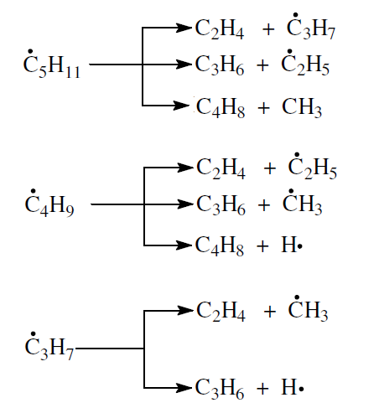
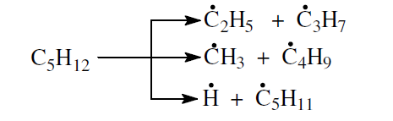
Main stages of thermal cracking
Initiation:
X → 2R∙
Pentane (example):
Notes:
The thermal cracking is a process of thermal decomposition of large molecules into small molecules with lower mass or carbon-chain length. During cracking both decomposition and synthesis reactions occur. Transformation occurs by the radical-chain mechanism. There are three main stages.
Initiation
X → 2R∙

Slide 8
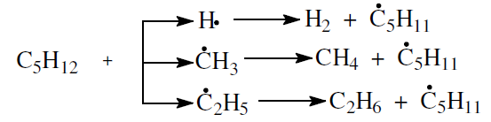
Chain continues:
R∙ + R’H → RH + R’∙
R∙ + CH₂ = CHR’ → RCH₂C∙HR’
Pentane (example):
Notes:
Chain continues
R∙ + R’H → RH + R’∙
R∙ + CH₂ = CHR’ → RCH₂C∙HR’

Slide 9
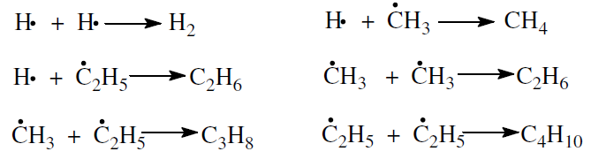
Chain breaks:
2R∙ → R₂
R∙ + R∙ → R’ + R’’
Pentane (example):
Notes:
Chain breaks
2R∙ → R₂
R∙ + R → R’ + R’’

Slide 10
Coke formation
Hydrocarbons
↓
Resins
↓
Asphaltenes
↓
Solid products (Coke)
Notes:
In liquid phase during thermal cracking coke can form. It is formed due to decomposition of arenas or results from the secondary reactions of deep decomposition of alkanes, cycloalkanes and alkenes following the scheme:
Hydrocarbons → Resins → Asphaltenes → Solid products (Cokes)
The coking process in undesirable.

Slide 11
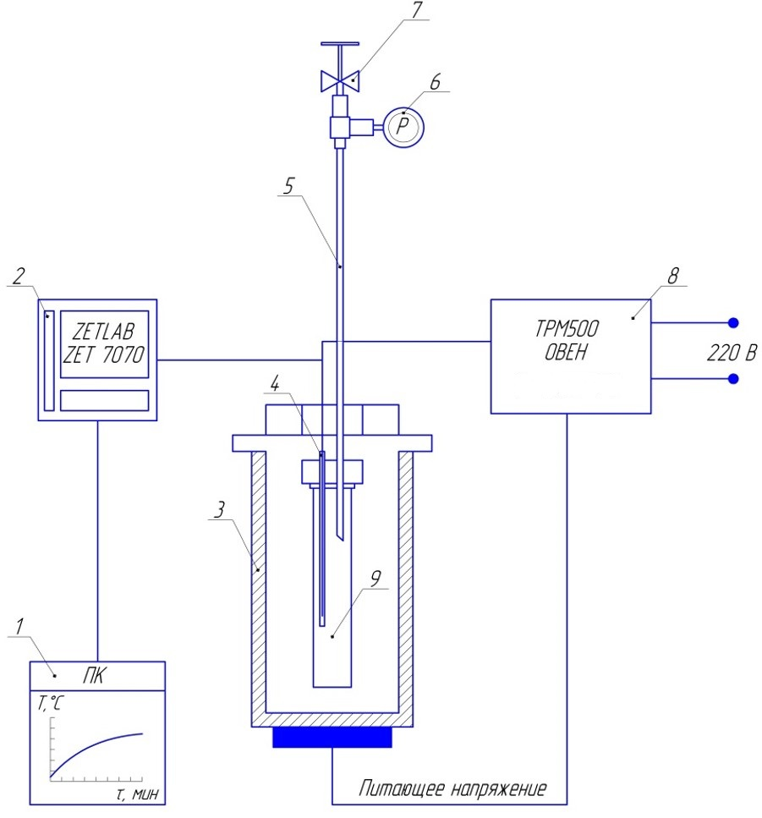
1-PC
2-USB ↔ RS-485 interface converter
3-Stove
4-Thermocouple
5-Exhaust pipe
6-pressure gauge
7-Crane
8-Thermostat
9-Reactor
Figure 2. Setup for thermolysis
Notes:
Thermolysis was carried out in a reactor placed inside a pipe furnace.

Slide 12
Scheme of the experiments
Thermolysis:
Fuel oil
Vegetable oil
Fuel oil + Vegetable oil (oil content varied from 2 to 10 % wt.)
Fuel oil + Microspheres (10 % wt.)
Fuel oil + Vegetable oil + Microspheres
(oil content – 8 % wt., microsphere content – 10 % wt.)
Condition:
Temperature 450^{о}С
Duration 120 min
12
Notes:
The oil content in the mixture varied from 0 to 10%. Thermolysis was carried out without the addition of oil as well and with a mixture of oil, fuel oil, and microspheres.

Slide 13
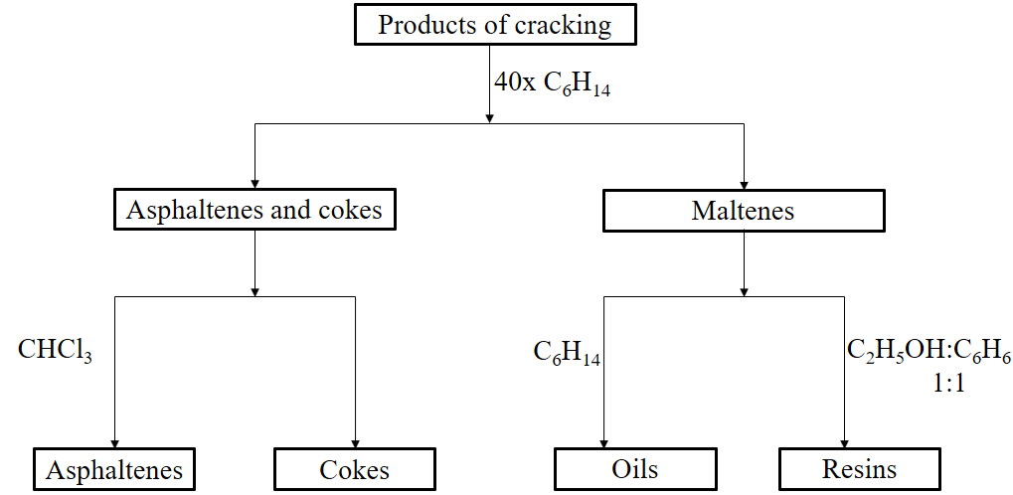
Figure 3. Separation of cracking products
Notes:
The Products were separated into gas, liquid (Asphaltenes, resins and oils) and solid phase by the following scheme.

Slide 14
Yield of distillate fractions
+25.1 %
+8.3 %
Fraction IBP-200°C
Fraction 200-360°C
Summary fraction output
Notes:
Max output fraction of b.p.-360°С (three hundred sixty degrees boiling point) is achieved with 8% oil content.

Slide 15
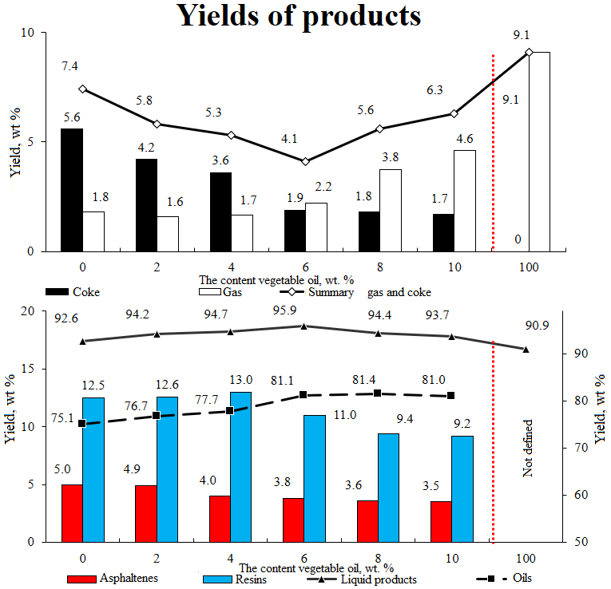
Yields of products
*
Notes:
Addition of oil results in decrease in output cokes, asphaltenes and resins with increase in gas.

Slide 16
Yield of distillate fractions
+32.8 %
+7.7 %
F
F / M
F / O
F / O / M
O / M
O
Fraction 200°C
Fraction 200-360°C
Summary fraction output
Legend: F – fuel oil; O – Unrefined vegetable oil; M – microspheres;
Composition:
F / M = 90 : 10 мас. %;
F / O = 92 / 8 мас. %;
F / O / M = 82.8 / 7.2 / 10.0 мас. %;
O / M = 90 / 10 мас. %;
Notes:
Addition of microspheres leads to a greater increase in fractions output.

Slide 17
Yields of products
Legend:
F – fuel oil;
O – Unrefined vegetable oil; M – microspheres;
Composition:
F / M = 90 : 10 мас. %;
F / O = 92 / 8 мас. %;
F / O / M = 82.8 / 7.2 / 10.0 мас. %;
O / M = 90 / 10 мас. %;
F
F / O
F / O / M
O / M
O
Coke
Gas
Summary gas and coke
* - Its content fatty acids (oleic and linoleic) mostly
*
*
F
F / M
F / O
F / O / M
O / M
O
Asphaltenes
Resins
Liquid products
Oils
Notes:
The product contains increased amount of gas, coke and asphaltenes but smaller amount of resins.

Slide 18
Table 5. Composition of gaseous products
Components | Composition of the initial mixture
 | The content oil, wt. % |  | With oil and microspheres
 | 0.0 | 8.0
 | The content, wt. %
H₂ | 0.01 | 0.02 | 0.03
CO | 0.01 | 0.21 | 0.27
CO₂ | 0.08 | 0.32 | 0.71
CH₄ | 1.07 | 1.52 | 4.62
C₂H₄ | 0.01 | 0.03 | 0.05
C₂H₆ | 0.22 | 0.46 | 0.69
C₃H₈ | 0.19 | 0.65 | 0.84
C₃H₆ | 0.04 | 0.09 | 0.25
Notes:
The analysis of gaseous products has shown that by with adding oil output of carbon oxide, carbon dioxide, alkanes and alkenes c1-c4 increases. Addition of microspheres increases the output of co, co2 and methane significantly.

Slide 19
Number of carbon atoms different types
in medium molecule of asphaltenes
1800
129.5
545
502
339
Molecular mass
55.9
46.8
39.4
35.9
26.7
25.7
24.5
17.4
17.5
14.2
11.5
9.0
2.2
0.9
1.2
Basic F
F
F / O
F / O / M
C basic
C naphthenic
C paraffin
C aromatic
Notes:
Also, structural-group analysis (SGA) of medium molecules of asphaltenes and resins has been done. In case of both adding oil (and increasing its content) and adding microspheres, we observe the same results. Main parameters such as molecular mass, basic number of carbon atoms, number of carbon atoms of different types are reduced.

Slide 20
Number of carbon atoms different types
in medium molecule of resins
850
790
55.7
55.2
699
46.7
402
40.1
Molecular mass
28.1
25.2
24.1
20.1
16.2
14.2
14.8
11.8
12.2
3.3
2.5
1.1
Basic F
F
F / O
F / O / M
C basic
C naphthenic
C paraffin
C aromatic
Notes:
Same results we see with resins.
This is only a part of the work. We will do all of this with other fuel oil. Reaction kinetics will be studied, a scheme of conversion of resins and asphaltenes will be suggested and influence of vegetable oil will be shown in future.

Slide 21
Thank you for your attention
Notes:
Thank you for your attention!

