Slide 1
Characteristics of mesoscale convective complex over the south of Western Siberia
Institute of Monitoring of Climatic and Ecological Systems of the Siberian Branch of the RAS
Тatyana Koshikova
postgraduate student
takosh_10@mail.ru
Notes:
Hello! I would like to spend the following 8 or so minutes to the
mesoscale convective systems, to tell you what it is, how it affects people’s lives and what characteristics it has on the example of the southern region of Western Siberia.

Slide 2
Purpose:
spatial and temporal assessment of the МСС and microphysical characteristics of clouds.
Notes:
Purpose: spatial and temporal assessment of the МСС and microphysical characteristics of clouds.

Slide 3
Content:
1. What is the mesoscale convective complex (MCC)?
2. The study
3. Spatial and temporal assessment of the MCC in the south of Western Siberia
4. The calculation of statistical characteristics
5. Conclusion
Notes:
First we will find out what “MCC” is, then I will tell you what data was used in the work and describe the research algorithm, then we will go on to analyze the results, and finally draw some conclusions to wrap it all up, should you have questions, please keep them until after I’m done.

Slide 4
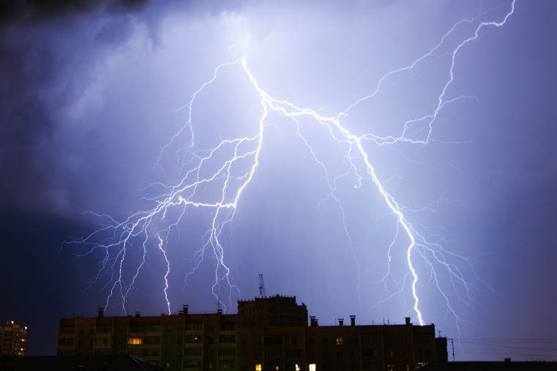
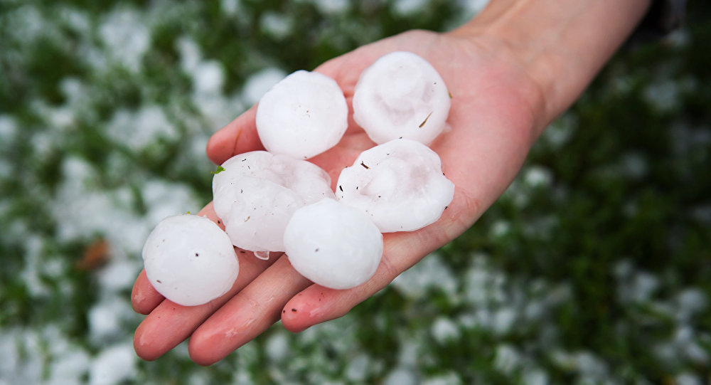
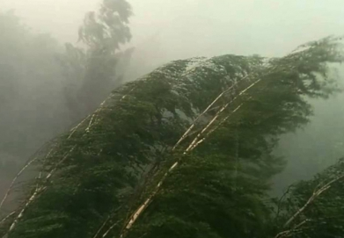
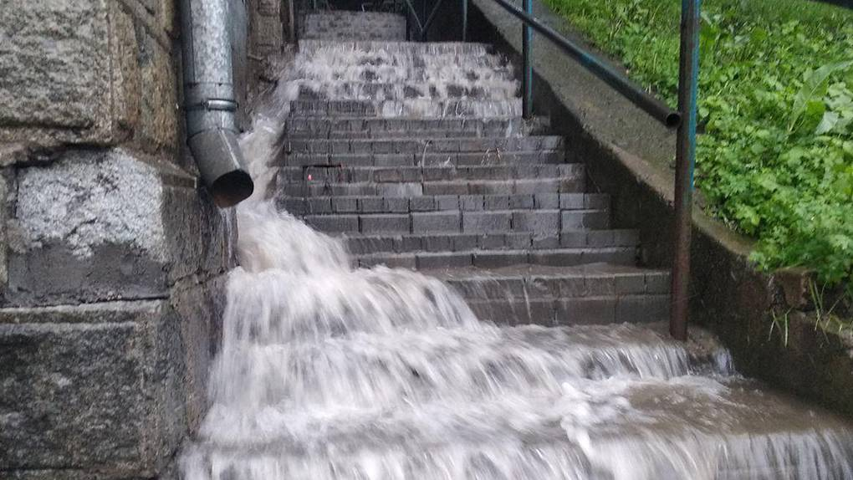
MCC is:
Cumulonimbus cloud complex, united by a common peak that has an oval shape;
average area: 200 km;
lifetime: 10-36 hours;
causes: thunderstorm, hail, rain, windsquall.
Notes:
MСC is cumulonimbus cloud complex, united by a common oval shape peak. An average MCC size is 200 km in horizontal plane, It exists for around 10 hours, sometimes up to 36. MCC is accompanied by such dangerous phenomena as: thunderstorm, hail, rain, windsquall.

Slide 5
Study period and territory
Study period:
Study area:
from April to September 2010-2019
South of Western Siberia (50–60 º N, 70–90 º E)
Study area
Notes:
The study was conducted in the south of Western Siberia, during warm months from 2010 to 2019

Slide 6
Damage caused during the formation and evolution of the MCC
Novosibirsk region:
july 21-23, 2009;
21.5 million rubles of damage;
lodging of crops on 2500 hectares of the territory.
Notes:
The slide shows the damage caused during the passage of an MCC.
During the study period, the number of days with registered damage was 49. The largest damage was recorded in the Novosibirsk region in July 21-23, 2009. 2500 hectares of crops were lost due to lodging, The damage amounted to 21.5 million rubles.

Slide 7
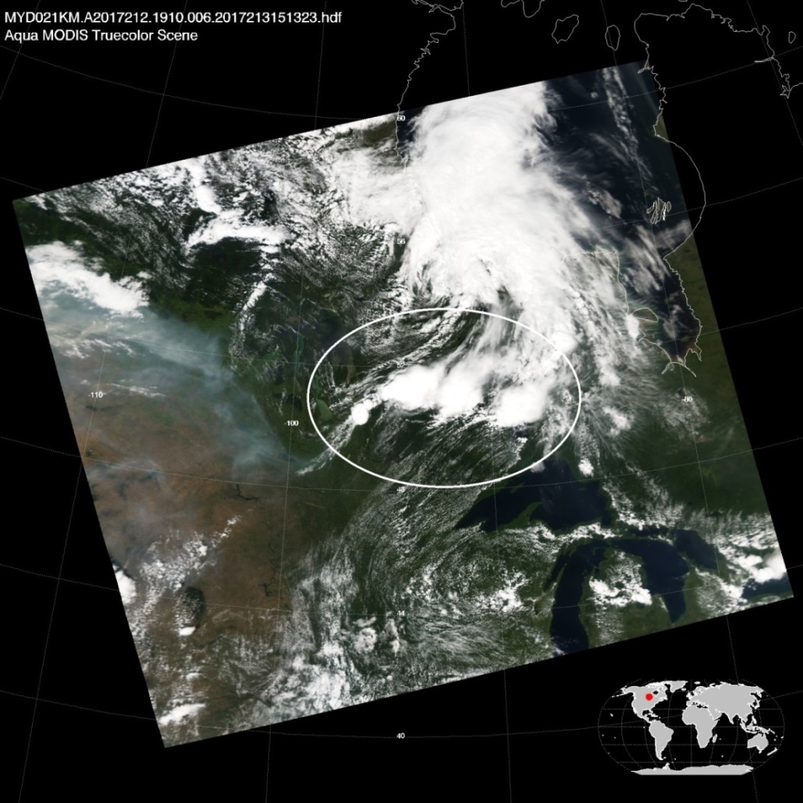
The analysis
RGB images from satellites Agua, Terra, Suomi NPP;
Cloud product ATML2
Cloud product ATML2
7
Notes:
For the study we used RGB images acquired from the satellites and ATML2 data.

Slide 8
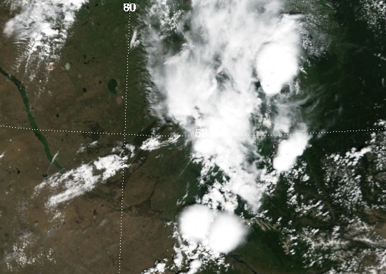
Interpretation of mesoscale convective complexes
Selection criteria:
Cloud Top Temperature
≤ 200 K (-32 ºС);
The area of the MCC
≥ 104 km²;
A total of 462 cases of passing the MCC.
Cloud Optical Thickness
≤ 30;
Image in the visible light spectrum of the MODIS KA Terra for June 22, 2017, flyover time 05:45 UTC.
Notes:
To interpret the MCC, the selection criteria were identified: first, the Cloud Top Temperature should be less than -32 ºС; second, the MCC area more than 10⁴ km²; and the last Cloud Optical Thickness less than 30.

Slide 9
Spatial-temporal distribution of the MCC
Notes:
The figure shows the spatial-temporal distribution of the MCC. The maximum recurrence of the MCC observed in areas of the south-east of the Altai region, in the north part of the Altai Republic and in the eastern part of the Kemerovo region. This is due to the heterogeneity of the relief. For most years, this distribution is characteristic, except when seasonal fires exceed the annual normal in the area, when smoke plumes spread over the territory. In these years, the distribution of MCC becomes heterogeneous.

Slide 10
Temporal variability of the MCC
The time course of the MCC recurrence for the period between 2010 and 2019
10
Notes:
The graph shows the time course of the MCC. During the study period, from 20 to 70 cases of MCC were recorded every year, 46 cases on the average. The maximum was recorded in 2016 - 72 cases - because the study area suffered from a heatwave that year. The minimum number of MCC was recorded in 2019 - 20 cases. This was due to severe forest fires in Siberia. The smoke plumes created zones of stable stratification.

Slide 11
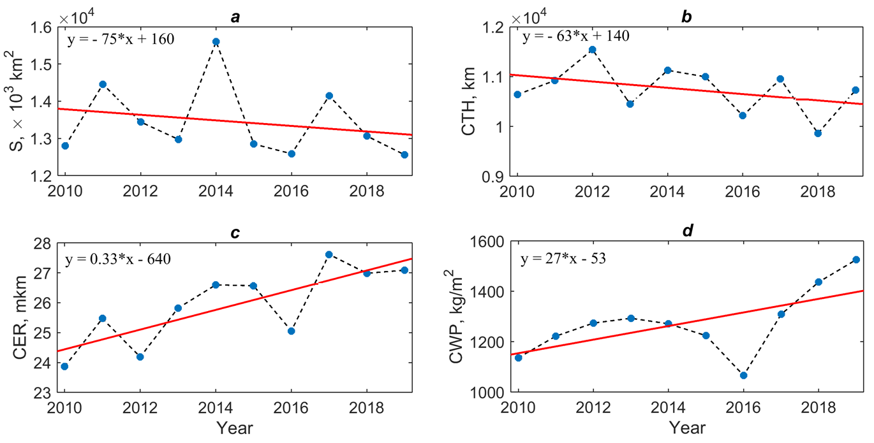
Temporal variability of the MCC
The area distribution of the MCC (a), the Cloud Top Height (b), the Cloud Effective Radius (c) and the Cloud Water Path (d).
(dashed curve - average values, red curve - trend)
11
Notes:
According to the graph an average area of an MCC is 13600 km², and varies in the range of 10³-20³ km². CTH is 10 km on the average, varies from 5 to 16 km. CER is 26 microns on the average, varies from 10 to 33 microns. CWP is 1210 g/m² on the average, the values vary from 371 to 2629 g/m². It was found that in 2013, 2016, and 2018 marked the minimum values of these characteristics and for the year 2011, 2014, and 2017 they reach their maximum values. As a result, we observe a two-year cycle in the variability of the MCC characteristics in the south of Western Siberia.

Slide 12
Сonclusions:
the MCCs are mostly localized in the southeastern part of the study area. In years when strong forest fires in Siberia were recorded, MCC distribution can be significantly disturbed.
MCC count varies from 20 to 70 per year;
We observe a two-year cycle variability in the characteristics of the MCCs in the south of Western Siberia during the study period.
1
2
3

Slide 13
Thank you for your the attention!

