Slide 1
Institute of Petroleum Chemistry
The chemical composition of soils in the territory of an oil refining facility
Natalya Volkova, PG student
Tomsk 2020
Notes:
Good morning respected colleagues and chairpersons. Thanks for the introduction.
Today I will be sharing some knowledge on ways to detect soil contaminants in the vicinity of an oil refining facility.

Slide 2
Contents
general problem
types of contamination
the methods
the results
Notes:
We’ll start with general problem statement, then we will consider types of contamination, then, turn to an actual research my colleagues and I have conducted. In the last part I’ll say a couple of words about the methods we used, and the results. This is my first time doing this in English, so in case there are questions, please retain them until I’m finished.

Slide 3
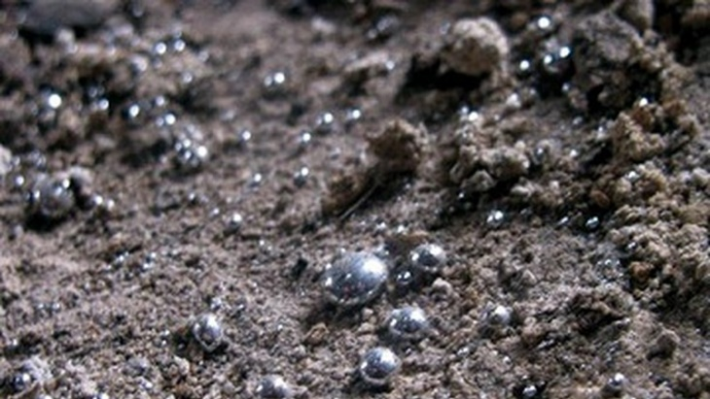
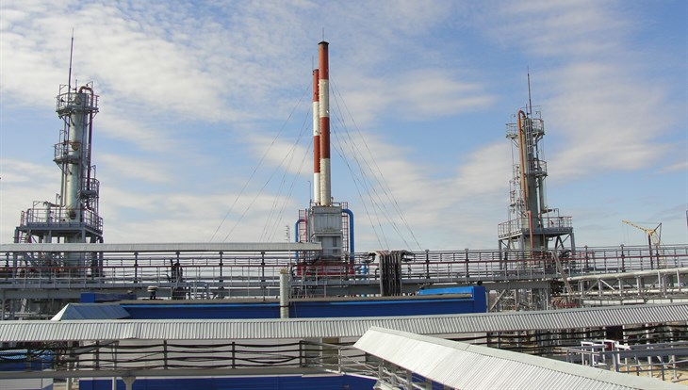
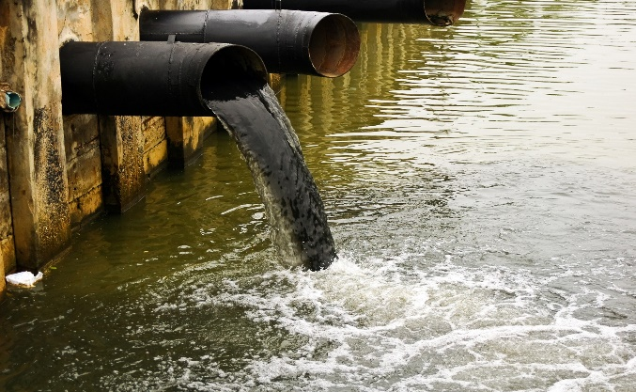
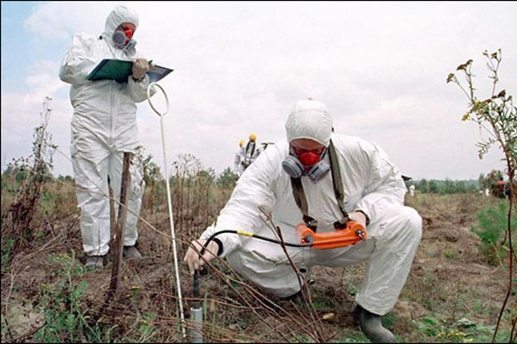
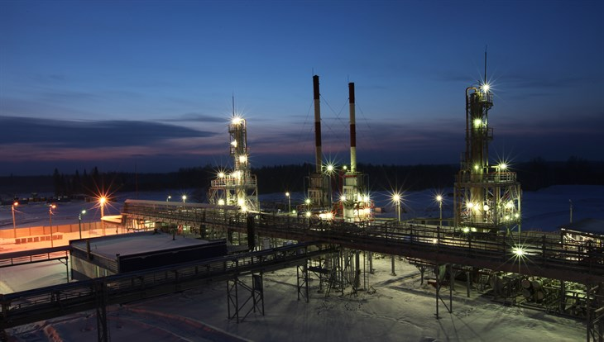
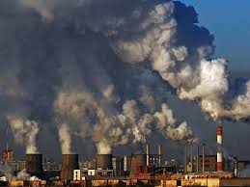
Problem
Emissions
Oil refining facility
Control
Notes:
An increase in the growth of oil production, the geography of its transportation, refining and consumption lead to a global deterioration of the environmental situation. Oil and its refined products, as well as heavy metals, are detrimental and have a drastic effect on ecosystems. The concentration of hazardous compounds should be monitored and an assessment of the degree of contamination has to be developed.

Slide 4
The main types of pollution
Mineral and organic fertilizers
Pesticides
Household waste
Heavy metals
Oil and oil products
Garbage
POLLUTION
Notes:
There are many types of pollution, the main ones are presented on the slide.
This study focuses on heavy metals and organic matter.

Slide 5
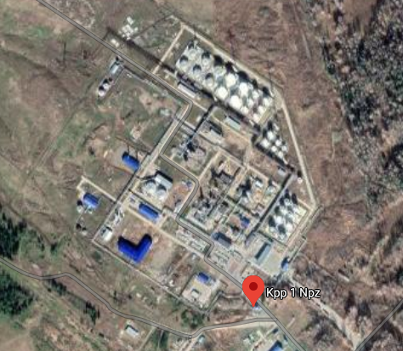
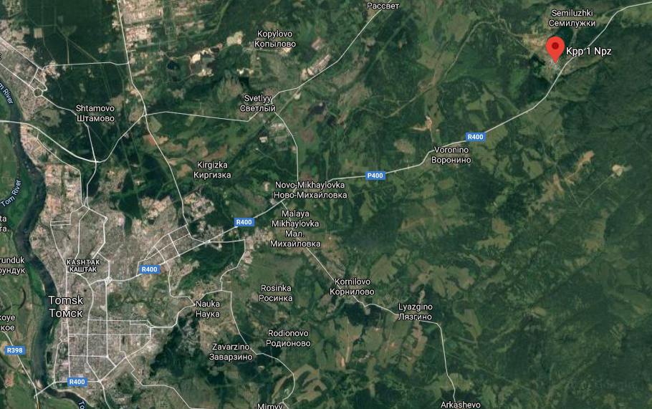
Object of study
The soil from a depth 0-10 and 10-20 cm
The ‘Tomskneftepererabotka’ (TNP) factory
located 1.5 km away from Semiluzhki village of the Tomsk region, and 25 km away from Tomsk
Location selection
200 m to the east
300 m to the west
1.5 km to the north-west
100 m to the south
1.5 km to the north, the outskirts of Semiluzhki village
Notes:
The object of the study is the soil collected after snow melting in mid-May from a depth 0-10 and 10-20 cm near the ‘Tomskneftepererabotka’ (TNP) factory, located 1.5 km away from Semiluzhki village of the Tomsk region, and 25 km away from Tomsk and in the immediate vicinity of the ‘Transneft’ pipeline. Its main production line is the production of petroleum products.

Slide 6
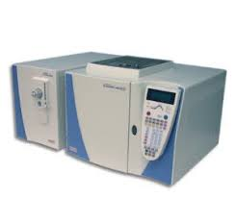
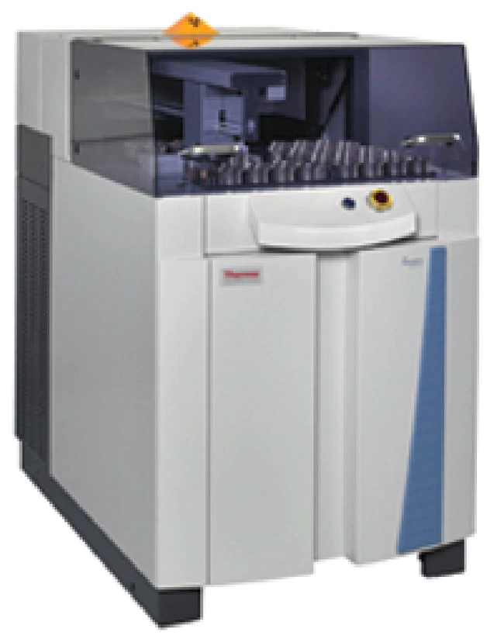
Methods
1. Gas chromatography-mass spectrometry (GC-MS)
using a Trace DSQ instrument from Thermo Scientific Company (Germany)
-Soil samples were pre-dried and sieved
-Organic matter was extracted from the soil with vapors of
7 % solution of methanol in chloroform
2. X-ray fluorescence analysis
-The samples were dried at 105⁰С for one hour, sieved
-Pressed with Н₃ВО₃ to get hard-packed tablets
Notes:
Soil samples were pre-dried and sieved. Organic matter was extracted from the soil with vapors of 7 % solution of methanol in chloroform. The extract portions were combined, dried over anhydrous sodium sulfate and evaporated on a rotary evaporator. The compositional analysis of the extracts was performed via gas chromatography-mass spectrometry using a Trace DSQ instrument from Thermo Scientific Company (Germany).
To determine the composition of micro- and macroelements in the soil, the samples under study were dried at 1050С for one hour, sieved, then pressed with boric acid to get hard-packed tablets. The analysis was performed on an ARL-9900 XP X-ray fluorescence spectrometer.

Slide 7
Results
The organic compounds
n-alkanes (Alk)
aromatic hydrocarbons (AHC)
carboxylic acids (CA)
their methyl (ME) and isopropyl (IPE) esters
ketones (Ket)
tocopherols (TF)
oil hopanes (OH)
triphenyl phosphates (TPP)
Notes:
Among the organic compounds n-alkanes (Alk), aromatic hydrocarbons (AHC), carboxylic acids (CA) and their methyl (ME) and isopropyl (IPE) esters, ketones (Ket), tocopherols (TF), oil hopanes (OH), triphenyl phosphates (TPP) have been identified. The carbon preference index of alkanes CPI (C20-C32) characterizes the ratio of the contributions of alkanes of technogenic and natural origins. It is known that CPI values for oil n-alkanes are close to 1, while biogenic Аlk CPI these values can reach 6-10.

Slide 8
Results
Macronutrients
Si, Al, Fe, K, Ca, Na, Mg, Ti, Mn, P, S, Zr
Trace elements
Ni, Co, Zn, Sn, Cu, As, Cd, V, Se, Te, Rb,
Ag, Hg, Pb, Sb, Cs
Fig. 1 Average content the elements in the sample (%)
Notes:
The composition of trace elements is represented by Ni, Co, Zn, Sn, Cu, As, Cd, V, Se, Te, Rb, Ag, Hg, Pb, Sb, Cs. Macronutrients include the elements that exceed 0.1% in the earth crust, their composition includes Si, Al, Fe, K, Ca, Na, Mg, Ti, Mn, P, S, Zr.

Slide 9
Results
Toxic elements
Hg, Pb, Cd, Ni, Se, V, Zn, Cu, As, Mn
The values of metal concentrations exceed the maximum allowable concentration
Notes:
Heavy metals with toxic properties are of greatest interest. This group includes metals such as Hg, Pb, Cd, Ni, Se, V, Zn, Cu, As, Mn. Many metals were found in the analyzed samples, with the exception of Hg, Se, Cd, which are present in some of them. The values of metal concentrations exceed the maximum allowable concentration, which is the result of factory emissions and accumulation over a long period.

Slide 10
CONCLUSIONS
The study revealed pollution with both heavy metals and organic substances.
Such high indices are attributed to a large amount of emissions and leakage from the factory.
The accumulation of heavy metals causes a detrimental effect, causing mutations and changes in living organisms and plants.
Rectification of the consequences of pollution is the next step of our work.

Slide 11
Thank you for your attention

