Slide 1
Automatic 3D mapping of aerosol plumes according to LIDAR sensing data
Institute of Atmospheric Optics SB RAS
Student: Zhang Shuo
Supervisor: Konstantin Osipov
2020

Slide 2

The purpose of the research
Design and develop a software and hardware complex for assisting Lidar measurement. It can process and record Lidar measurement data in real time to achieve real-time monitoring of smoke plumes and aerosols and automatically draw their diffusion images.

Slide 3

Tasks
1. Real-Time Multi-data Acquisition
2. Fusion of multiple data streams and overlay with map
Notes:
When we make lidar measurements, we not only need to analyze the backscatter signal, but also need to collect the distance, altitude and meteorological information of the measured object. The obtained information is fused by the microprocessor and overlayed with the map.
(1.When recording LIDAR measurements and further processing, it is often necessary to possess information about weather conditions at the time of the measurement.
2.When measuring using mobile LIDAR complexes, it is necessary to know the coordinates of the location of the experiments and the direction of sounding.
3.When using LIDAR technologies for obtaining meteorological data, or when sensing the atmosphere for environmental monitoring, it is advisable in real time to attach the measurement results to a map of the area and to obtain a three-dimensional image of an aerosol plume (3D mapping).)

Slide 4
Research methods
Research
Surveys
Data analysis
Experiments
Notes:
1.Surveys
①Can understand the history, current situation, and development trends in this area, which will be more helpful for the research.
② By collecting and reorganization relevant literature, can fully understand and master the method of studying this problem.
2.Experiments
Through experiments, we can get relevant datd, and it is the basis for the next step "data analysis“.
3.Data analysis
First, judge the rationality of the data based on the experiments. If the deviation is large, you need to find the reasons and solve it. Then use these corrected data to determine the relevant parameters of aerosol and plume.
The three methods are not independent of each other, but they are supplementary to each other.

Slide 5
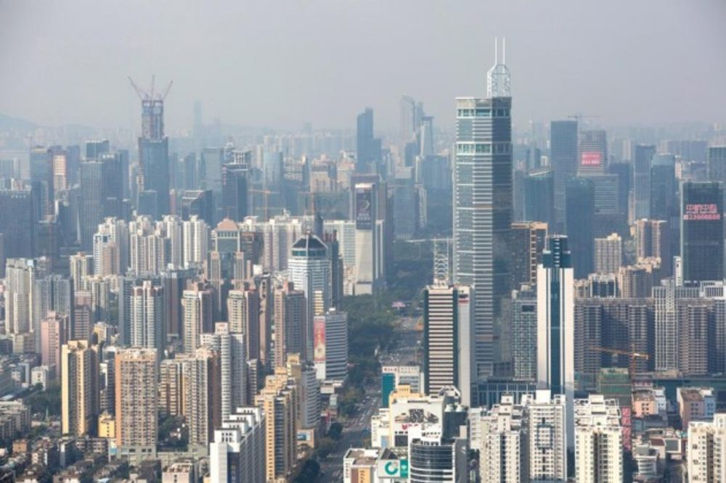
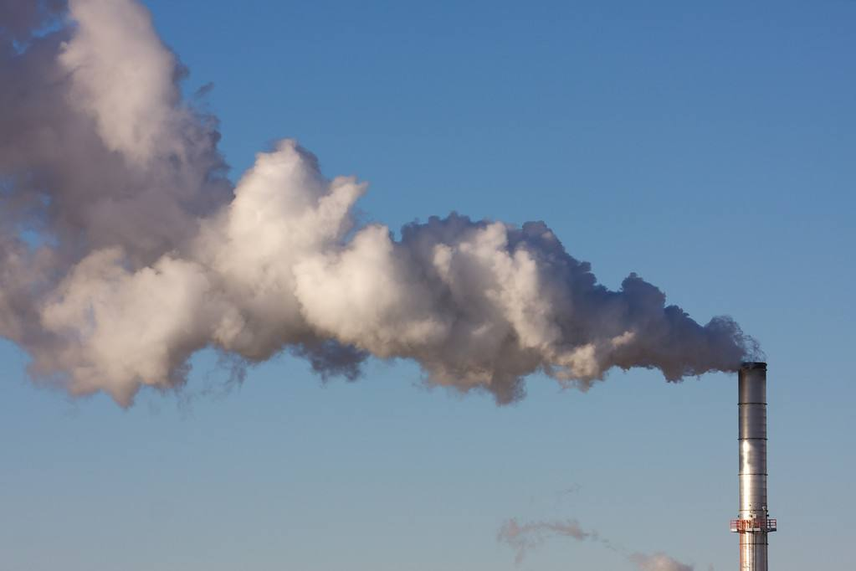
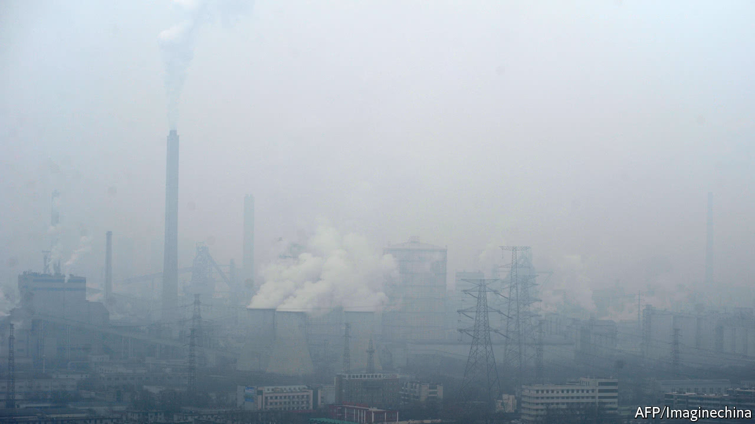
Background
Notes:
With the rapid development of urbanization, the pollution of atmospheric has become one of the main problems that can not be neglected. The problem of regional particulate pollution has had a substantial impact on human health, traffic safety, and climate change. Therefor , it’s important sense for the detection and research of atmosphere.
The research of the atmosphere highlights remote methods, including laser methods for obtaining information. Among the laser technologies, one of the most effective and promising technologies is Lidar sensing.And when recording Lidar measurements and their further processing, it is also necessary to have information like weather and coordinates ... at the time of measurement. Therefore it's necessary to develop the software-hardware complex for automatic mapping and logging of Lidar measurements.

Slide 6
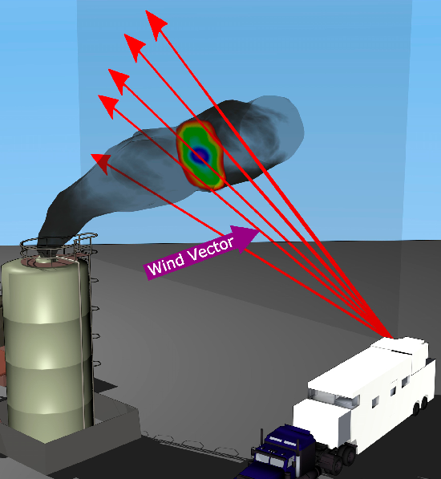
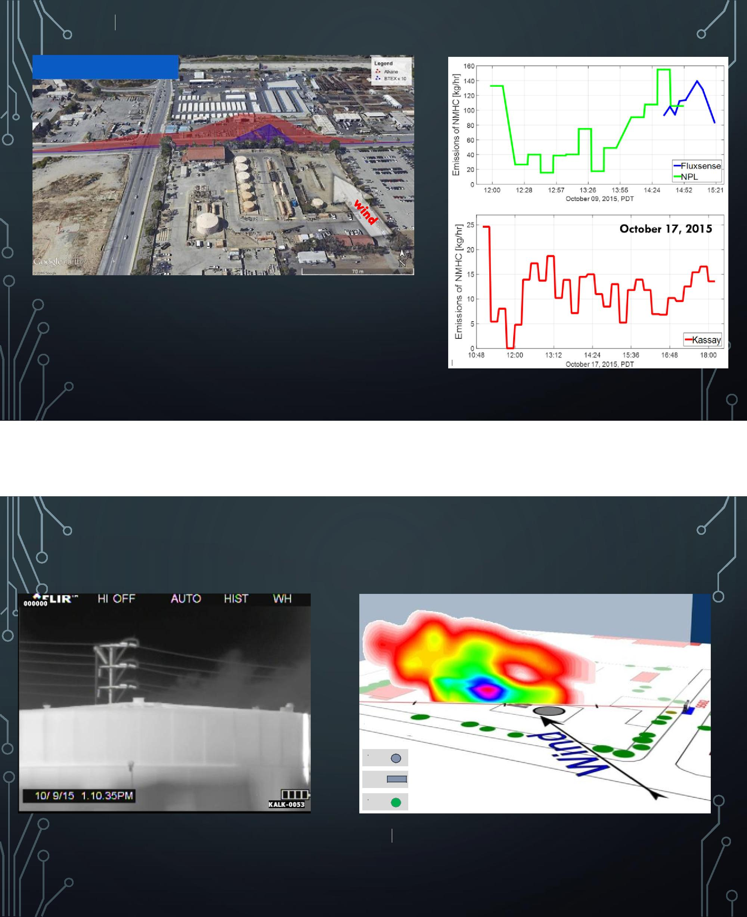
Instruction
Lidar (Light Identification Detection and Ranging) is one of the means of a remote collection of information about processes and objects in the atmosphere.
Diagram of Lidar measurement
Notes:
Lidar can be either with a fixed or a variable direction of propagation. It depends on the object of study. The use of scanning systems in Lidar can be allowed to change the direction of propagation and direct the Lidar to the object of study, and for three-dimensional objects or large-scale observations, scan them over the entire volume, or scan a specific controlled.

Slide 7
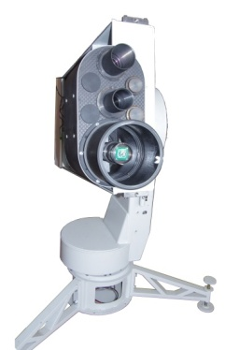
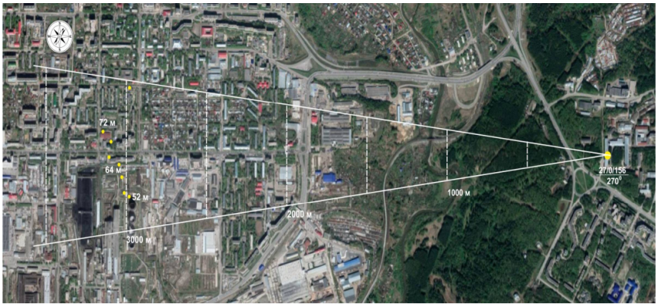
Aerosol lidar
Overlaying Lidar sensing data on a satellite map
Notes:
Now a new system is named "Mobile Multiwave Scanning Aerosol Lidar" , that is designed by the Institute of Atmospheric Optics. The system will include, among other equipments, also need to develop an assistant system - a software-hardware complex for automatic mapping and logging of Lidar measurements.

Slide 8

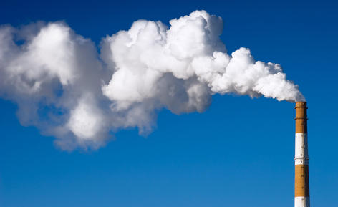
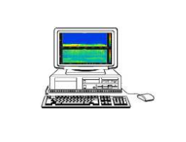
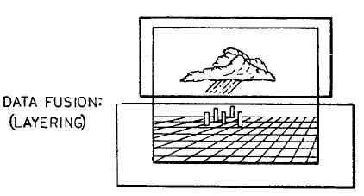
Backscatter signal
Data stream
Map
Diffusion images in real time
source of laser
Microprocessor
(e.g. Xmega)
GPS
INS
Notes:
Process description
Firstly, a laser with a specific wavelength is emitted to the observation target and then collect the backscatter signal. At the same time, the GPS module in the complex can get the position coordinates and INS module to obtain the elevation and azimuth. Now we can get three main data streams, LIDAR data stream(distance to the object, height of the object, backscatter signal intensity), coordinates of measuring points, elevation and azimuth. Then through the programs and algorithms developed as part of the described work, three data streams are calibrated, combined and finally overlying with a map for real-time monitoring of atmospheric aerosols.

Slide 9
Research plan
№5
№4
№1
№2
№3
1.Design the system structure and select the corresponding software and hardware according to the requirements.
2.Receive data from three streams (Lidar, GPS, INS), and calibrate GPS (Global Positioning System) and INS (Inertial Navigation System) data by using programs and algorithms.
3.Making the fusion of the three data streams through the microprocessor.
4.Superimposing the coordinates of the sensing object and information about the intensity of the backscatter signal on the map.
5. Checking the stability and accuracy of the complex in various conditions, if necessary, adjusting programs and algorithms.

Slide 10
Conclusion
The complex is able to integrate into various systems of remote laser sensing of the atmosphere. The equipment of the complex system will allow the use of the data to users who are not specialists in optics and remote laser sensing - ecologists, emergency monitoring services, meteorologists, etc.
Immediately during the execution of the described work, the complex will be implemented in the Lidar system designed for users in China.

Slide 11
References
[1] Wang Yingjian, Hu Shunxing, Zhou Jun, et al. Measurement of Atmospheric Parameters by Lidar [M]. Beijing: Science Press, 2014(in Chinese).
[2] Northend C A, Honey R C, Evans W E. Laser radar (Lidar) for meteorological observations [J]. Review of Scientific Instruments, 1966, 37(4): 393-400.
[3] Sun Jingqun Laser detection of smoke plume height [J]. Acta Scientiae Circumstantiae, 1983, 3(3) :203-206 (in Chinese).
[4] Ligda M G H. Meteorological observations with a pulsed laser radar [C]. Proceedings 1st Conference on Laser Technology, 1963: 63-72.

Slide 12
Thank you!

