Slide 1
Deposition of the dielectric coating from plasma
Daniil Zuza
Ph. D Student
Institute of High Current Electronics SB RAS
RAST-2020
Notes:
Good afternoon everybody. I don’t know about the others, but I am grateful for the opportunity to talk about my work in a foreign language. I want to use the possibility to talk about practical aspects of deposition of dielectric coatings from plasma.

Slide 2
INTRODUCTION
What will I talk about
What is plasma polymerization?
What problem do we want to solve using plasma polymerization
Setup for plasma-polymer deposition, which was made in our laboratory
Our first try to deposit coating
2
Notes:
Although none of my colleagues would consider it necessary to emphasize the relevance of this topic, I will say a couple words about that
After that, we will turn to the experiment, That I am a part of, no, I’m not a coating, if you are wandering. I will tell about the setups built at our laboratory.
Next we will turn to the results of the experiments and try to make sense of it.
But let's start with the introduction

Slide 3
INTRODUCTION
PLASMA POLYMERIZATION PROCESS
THE NON-THERMAL PLASMA
ADD THE PRECURSOR INTO THE PLASMA
ACTIVATION OF THE MOLECULES
e⁻
I⁺
e⁻
I⁺
e⁻
I⁺
e⁻
e⁻
e⁻
I⁺
I⁺
I⁺
⁺
M
M
e⁻
M
e⁻
M
•
e⁻
e⁻
e⁻
e⁻
M
M
•
I⁺
I⁺
I⁺
I⁺
I⁺
I⁺
M
M
•
e⁻ – Electrons
I⁺ – Ions
M – Molecules of precursor
M• – Radicals
M⁺ – Ions
DEPOSITION AND GROWTH
M
•
M
⁺
M
•
M
•
M
M
M
•
M
•
M
M
•
SUBSTRATE
Notes:
The principle of plasma polymerization is that charged particles have high energy in plasma. A Collision between high energy particle and a reactive gas molecule leads to activation of this molecule. Activated molecules, in turn, react with other molecules, forming molecules with higher molecular mass, and with the substrate, forming active sites on the its surface. When the surface is activated the growth of polymer film is initiated.
Today’s setups for investigation of plasma polymerization fall into two categories. First one is setups operating at low pressure from 0.1 to 100 Pa. The other one is setups operating at atmospheric or near-atmospheric pressure. The former are more common, better studied and have industrial application.

Slide 4
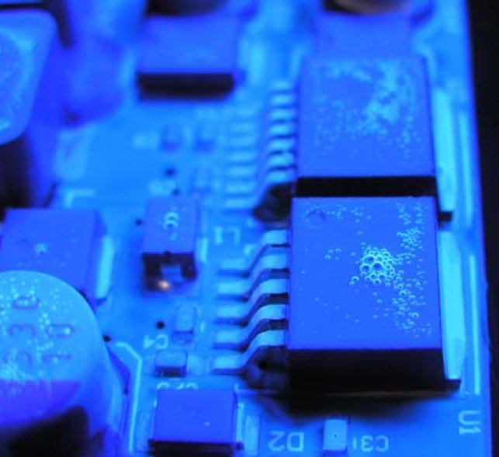
INTRODUCTION
Why are we doing this?
Our aim is deposition of the coatings for protect a printed circuit board's components
Conformal coating
Air bubbles under conformal coating
Notes:
In our work we focus on the possibility of deposition of polymer coatings from gas discharge plasma for electrical insulation of electronic circuit boards. Currently this is most topical in the field of spacecraft building, because under coatings made by conventional techniques (for example brush application or aerosol spraying) there may remain air bubbles, which lead to deterioration and destruction of the coating and eventually to electrical breakdown.

Slide 5
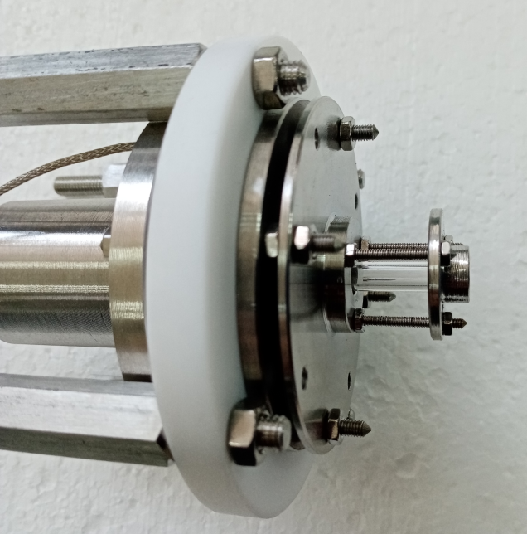
“VACUUM”
PLASMATRON
PLASMA-CHEMICAL REACTOR
COOLED HOLDER
PRECURSOR
SUPPLY
SYSTEM
POWER
SOURCE
Ar
TURBOMOLECULAR
PUMP
BAKING VACUUM
PUMP
PLASMA-CHEMICAL REACTOR
Photo of the plasmatron and the scheme of the setup for deposition from plasma “Vacuum”
Notes:
In our laboratory we have made one experimental setup of each type: plasmochemichal deposition setup operating under low pressure, which we called “Vacuum”, and plasmochemichal deposition setup operating under atmospheric pressure, which we called “Atmosphera”. Using these, a polymer coating was deposited and its dielectric strength was tested. For the sake of saving time the latter shall not be discussed here.
The setup “Vacuum” consist of the following parts
1. Naturally the vacuum chamber is equipped with a forevacuum and a chemical resistant turbomolecular pump.
2. The second part is non-thermal plasmatron with a hollow cathode for plasma generation. Cathode was equipped with а fitting for argon supply. During the deposition experiment the discharge burning voltage and rated discharge current was 200 Volts and 10 microAmpere, respectively. Concentration of the plasma was 1*10⁻⁹ along jet axis.
3. Precursor supply system. When we created the precursor supply system, we were faced with the fact that often other researchers did not pay attention to the fact that the precursor flow rate must be stabilized. Therefore we created own supply system. Precursor supply was set up with using a multistage engine, operating as a syringe pump. Precursor was supplied to the evaporator, which was glass capillary tube about 3 millimeters in diameter wrapped with nichrome wire. The precursor is vaporized instantly after getting it into the hot zone. This gives us control over the argon/precursor ratio over time.
4. Another part is Plasma-chemical reactor, the place where magic happens. Vaporized precursors are transported to the reactor, which is quartz tube 50 millimeters long and 3.5 millimeters in diameter. We specifically localized the plasma jet and precursor molecules in one small volume
5. And the last part is the substrate holder cooled by cryothermostat.

Slide 6

COATING DEPOSITION
Coating
DEPOSITION CONDITIONS
Pressure | 1 Pa
Wattage | 20 W
Precursor flow rate | 1 ml/min
Argon flow rate | 10 sccm/min
Deposition time | 15 min
Copper substrate
Image of deposited coating
Notes:
Now we are done with the boring technical part. I suggest we turn to our first attempt in trying and deposit the films using the setup. As you remember, the aim of our investigation was to obtain a polymer coating with both high electrical strength and good mechanical properties.
Here you see the conditions of under which the deposition was carried out. We used [2-2]paracyclophane as a precursor. The films were deposited onto 2 cm square copper plates. The temperature at the substrate surface was kept less than 20 ºC.
After deposition the coatings look homogenous and solid.
We subjected our coating to artificial aging test; particularly we used thermo cycling technique at the temperature range from -70 to 120 degrees Celsius. The coating from ‘’Vacuum’’ setup demonstrates the mass difference less than 10 percent which is a good result. Thus we assume, that we have a polymer films with high molecular mass.

Slide 7
ELECTRICAL STRENGHT MEASURE
POWER SOURCE
ROLLING BALL
Applied voltage, V | Result
100 | +
200 | +
400 | +
R
SUBSTRATE
V
Scheme of the measurement for contact scanning with an electrode in the form of a rolling ball
Notes:
After that, we tested the electrical properties of the coating obtained with “Vacuum”. The electrical strength was evaluated by contact scanning with an electrode in the form of a rolling ball at a voltage of 100, 200 and 400 V using a DC source. The results of the experiment showed that the coating successfully withstands the applied voltage.
However, there is a blot on the landscape. The coating does not adhere to copper. This may be due to insufficient ion energy, the substrate surface does not get activated. Therefore, our next step will be to tackle this problem.

Slide 8
CONCLUSION
Basic principles of creating setups for deposition of the conformal coatings from plasma
Composition of the gas mixture should be stabilized through an stabilized monomer vapor flow rate
There has to be a separate zone for plasma-chemical processes with use a flow-type reactor
“Experience is one thing you can't get for nothing.”
― Oscar Wilde
Notes:
To summarize we created and tested experimental setup for deposition of the coatings from plasma. We have established the core principles of creating such setups. Simply put we now know how not to do things in the future. For instance we can assert that the composition of the gas mixture should be stabilized through an stabilized monomer vapor flow rate. Another one is that there has to be a separate zone using a flow-type reactor instead of using the vacuum chamber itself as a reactor. This is necessary for the localization of plasma-chemical processes. All in all we gained invaluable experience in developing setups for coatings deposition.
That would be it and I kindly invite you to discuss the details I may have missed, omitted, or forgot to mention or was not entirely clear about.

Slide 9
THANK FOR YOUR ATTENTION!

